Slide 1


Adventures in Forensic Mathematics
Charles Brenner, PhD
DNA·VIEW and UC Berkeley Public Health
www.dna-view.com c@dna-view.com
Notes:
Likelihood ratios are in principle the right way to consider the evidence in any situation -- in life, not just genetics -- where two alternatives are under consideration, so it is an important and geneeral concept.
I'm sure it is quite familiar to you in the context of paternity investigation as an example. There we have evidence such as a Q allele shared between man and child, and note two possible explanations:

Slide 2
Resume
computer programming from 1958
  1982: learn genetics through consulting application
  1988-present: DNA∙VIEW™ core of business
pure math … - 1967 (B.S), 1978-84 (Ph.D)
applied math
  1968-1974 (bridge)
  1990-… (“forensic mathematics”)

Slide 3
DNA∙VIEW
  premier tool for DNA identification applications worldwide, especially complicated problems such as
    Mass disaster/deaths (WTC, Balkan war, Katrina, Christmas tsunami …)
    “Kinship”
      Generalization of paternity – missing body, inheritance, twin zygosity
    Mixtures (crime scene DNA from >1 person)
    Y-chromosome matching evidence

Slide 4
Forensic mathematics
mathematics of DNA identification
  paternity
    kinship – immigration, mass disaster, inheritance
  crime
    simple stain (probability of random match between crime scene DNA & suspect DNA)
    mixture (combination of DNA from several people)
  race from DNA
Population genetics
  modeling evolution / human history
  population differences & similarities

Slide 5
What is forensic mathematics?
Mathematics of evidence?
  (seems very reasonable)
Mathematics of DNA evidence
  Because that’s where mathematics fits.
  Because I say so.
    droit du seigneur
We’ll start with DNA.

Slide 6
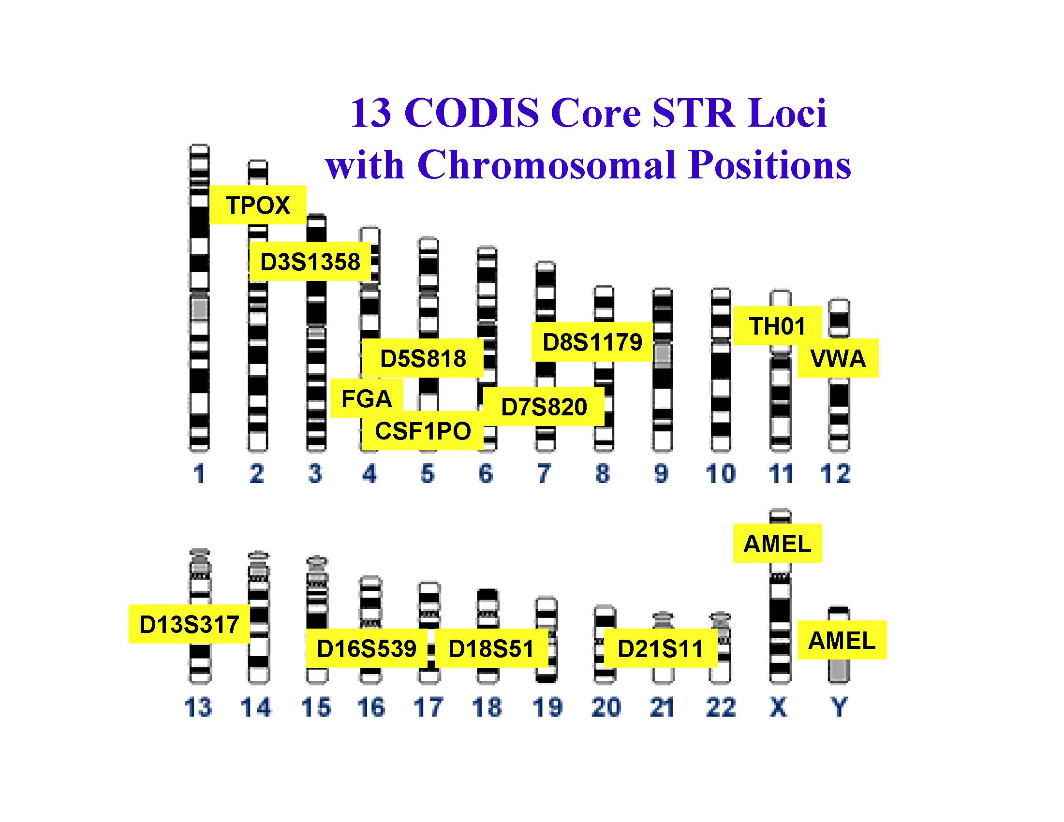
Human genome and forensic marker (=pseudo-gene) locations

Slide 7
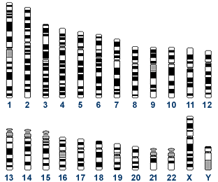
Forensic STR markers
locus TH01 (tyrosine hydroxylase), at position 11p15.5. (one locus, two loci)
Tetrameric repeat (AATG)⁶⁻¹⁰
E.g. a person might be {8,9} at TH01 – 8 tandem copies of the motif on one #11 chromosome, 9 copies on the other.
A DNA profile is typically 15 or so loci – e.g. {13,15}, {28,28}, {8,9}, …

Slide 8
Genetic inheritance
Each parent has two #11 chromosomes, hence two TH01 alleles – e.g. {6,9} and {8,10}
9
8
Each parent contributes a #11 chromosome, randomly selected, to the child.
Child thus has two #11 chromosomes, one from each parent, and shares a TH01 allele with each parent – e.g. {8,9}

Slide 9
Actual electron microphotograph detail of TH01
…
…
(one of the two TH01 alleles)

Slide 10
Know your nucleotides
Purines
Pyrimidines
Adenine
Thymine
Guanine
Cytocine

Slide 11
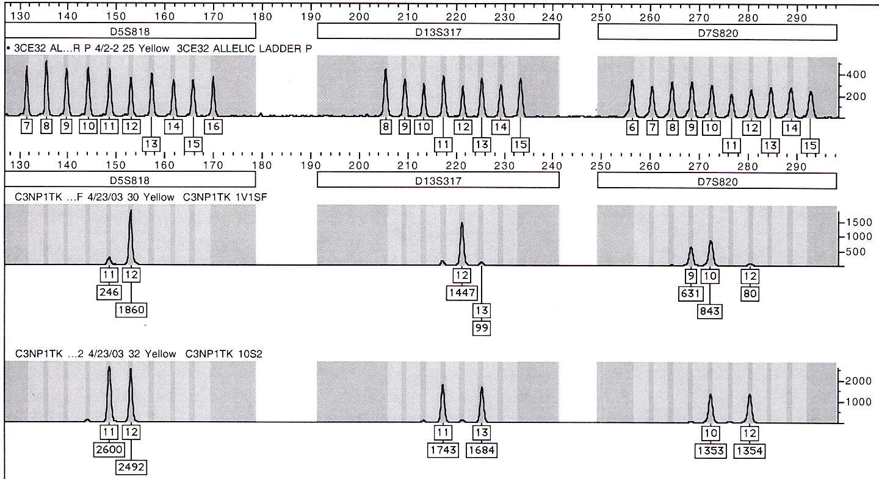
DNA profile today
Locus D13S317
D7S820
Calibration ladders
Person (reference profile)

Slide 12
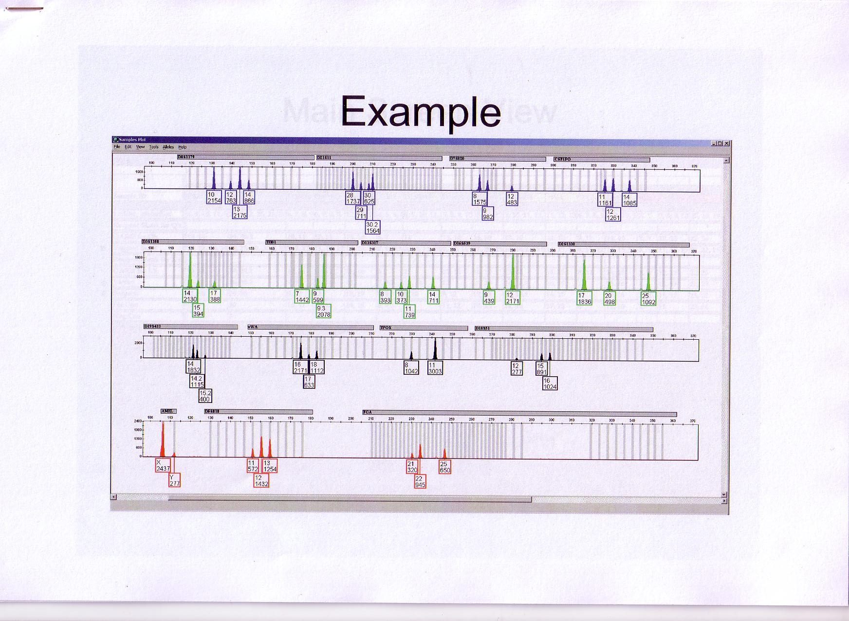
DNA evidence
Suspect (reference profile)
Crime scene sample
Same fragment molecular sizes
=evidence that suspect is source of crime sample
=evidence connecting suspect to crime scene

Slide 13
DNA evidence – mixture
Suspect (reference profile)
Crime scene sample
Shared fragment sizes
=evidence that suspect contributed to crime sample
=evidence connecting suspect to crime scene.
How strong is the evidence?

Slide 14
Digression: Mathematical models
Mathematics is abstract
World is real
How apply mathematics to the world?
Models
  Paint a house

Slide 15
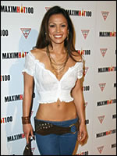

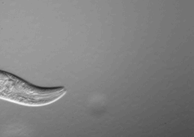
“Model” in what sense?
Accessible example
Smaller replica
Idealized version
Mathematical model: simplified or abstracted version; stripped to essentials

Slide 16
Houses
w
h
Mathematical
Real
A=wh
A≈wh
All models are wrong, but some models are useful.
G.E.Box

Slide 17
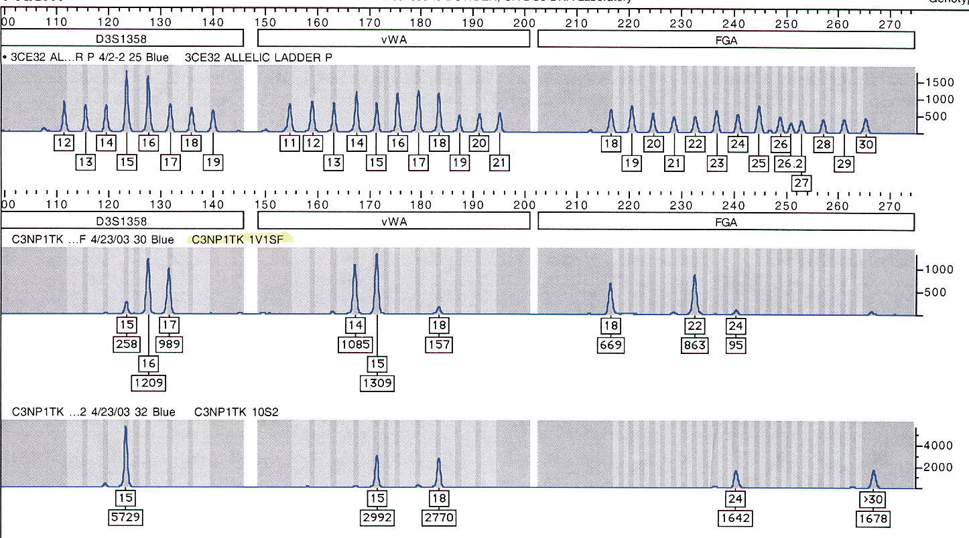
Some models
Mendelian genetics
  Random mating, no mutation, no migration
  Implies Pr(PQ genotype)=2Pr(P)Pr(Q)
Coins or dice are “fair” (symmetrical)
  Implies Pr(die lands 5)=1/6
  Suppose the die is “loaded”. Pr(5)?
    Depends on the model of “loading”!
    Example: If loading is random, Pr(5) = 1/6 as before.
PCR amplification
Mixture (FGA)
Suspect

Slide 18
Digression: Mathematical models
Mathematics is abstract
World is real
How apply mathematics to the world?
Models
  Paint a house

Slide 19

“Model” in what sense?
Accessible example
Smaller replica
Idealized version
Mathematical model: simplified or abstracted version; stripped to essentials

Slide 20
Mathematics of evidence
“Prior probability” (or prior odds)
  Confidence of proposition before considering DNA
DNA evidence
  Represented by ratio of probabilities (“Likelihood ratio” = LR)
“Posterior probability” (or posterior odds)
  Final confidence of proposition

Slide 21
Common thread is probability, so let’s start with that
“The law is concerned with probabilities, not certainties.”

Slide 22
Probability definition
short-range not good enough
The long-range rate of success of some conceptually repeatable experiment.
“success” – The “event” happens, i.e. is true.
Pr(X) implies that X is a true/false statement.
Pr(heads) must be shorthand, really means
Pr(The coin lands heads.)
it’s an imaginary experiment anyway

Slide 23
experiment: flip a coin
“50% chance of heads”
Meaning?
  What is the repetitive experiment?
Pr( )
H
H
t
H
t
t
t
t
H
H
…

Slide 24
Conditional probability
Pr( | this data)
R
X
X
X
X
X
R
R
R
R
…
X ^{=not “this data”}
R
R
R
R
…

Slide 25
Y chromosome example
What is Pr(person has a Y chromosome)?
  Very approximately 50%
What is Pr(person has Y | person is male)?
  100%
What is Pr(person has Y | in prison)?
  80? 90?

Slide 26
Pr(allele | ethnic group)
D8S1179 | Black | White | Colored
 | (90%) | (7%) | (3%)
11 | 0.03 | 0.08 | 0.14
13 | 0.22 | 0.34 | 0.26
15 | 0.21 | 0.09 | 0.11
Experiment – pick a #8 chromosome at random in S. Africa
Pr(Black)?
90%
Pr(11|Black)?
0.03
Pr(Black & 11)?
90%•0.03=0.027
Rule of “AND”: Pr(J & K) = Pr(J) Pr(K|J)
If Pr(K|J)=Pr(K), K & J are “independent”
K=height>2m. J=born on Tuesday

Slide 27
Rule of AND
Pr(J & K) = Pr(J) Pr(K|J)
If Pr(K|J)=Pr(K), K & J are “independent”
  K: “height>2m”. J: “born on Tuesday”
  K: “is male” J: “passes allele FGA#30”
If Pr(K|J)=0, K & J are “exclusive”.
  K: “TPOX allele is 9.3” J: “TPOX allele is 9”
If A, B, …, Z are mutually exclusive and Pr(A or B or … or Z)=1, they are mutually exclusive and exhaustive.

Slide 28
Rule of OR
Pr(A or B)=
  If (and only if) A,B mutually exclusive,
    Pr(A or B)=Pr(A)+Pr(B)
    Example: Pr(pat’l 8 or 9)=Pr(8)+Pr(9)
    Example: Pr(pat’l 8 or mat’l 9)<Pr(8)+Pr(9).

Slide 29
Genetic example
Suppose at locus D1S2 we have Alleles 2, 3, 4, and 5, respectively observed 10, 20, 45, and 25 times / 100.
Pr(random sperm=3)? Pr=20%
Pr(sperm=3 | man is 3,4)? Pr=50%.
Pr(sperm=3 | man’s father is 2,2) = x ?
  Two possibilities: M=sperm allele is mat’l; P=it is pat’l.
  x = Pr(sperm=3 & M | 2,2 father) + Pr(sperm=3 & P | 2,2 father)
  = Pr(M | 2,2 father)Pr(sperm=3| M & 2,2 father) + 0
  = Pr(M) Pr(sperm=3 | M)
  = ½ Pr(3)
  = 10%.

Slide 30
Genetic example
Suppose at locus D1S2 we have Alleles 2, 3, 4, and 5, respectively observed 10, 20, 45, and 25 times / 100.
Pr(sperm=3 | man born on Tuesday) = 20%.
  (Men born on Tuesday are no different from men in general.)

Slide 31
Kinds of probability
Some distinguish “objective probability”
  Coin flip, dice, cards
  DNA allele, profile “frequency”
  Science, laboratory
and “subjective probability”
  Probability witness is truthful
  Probability Obama wins another term
  Courts, prior probability
Difference: ease in imagining a “conceptually repeatable experiment”

Slide 32
Probability remarks
Is a summary of whatever information we may possess
  Depends on point of view

Slide 33
Likelihood ratio
Compares two explanations for data
The heart of “forensic mathematics”
  Forensic mathematics
  http://dna-view.com
definition: Ratio of two probabilities of the same event under different hypotheses
  superiority of one hypothesis in explaining event is measure of support for that hypothesis

Slide 34
Likelihood ratio – everyday example
LR principle: Data (E) is evidence for one hypothesis over another to the extent that the data is more probable under the one hypothesis than under the other.
Example: E: The dog is barking
H₁: There’s a stranger about (& dog isn’t hungry).
H₀: The dog is hungry (& there is no stranger).
Pr(barking | when stranger)
LR favoring “stranger” =
Pr(barking | when hungry)
= 84% / 7% = 12.
Barking is 12 times more characteristic of “stranger” than of “hungry”

Slide 35
Likelihood ratio – another dog
Evidence The dog is barking
H₁: There’s a stranger about (& dog isn’t hungry).
H₀: The dog is hungry (& there is no stranger).
Pr(barking | when stranger)
LR favoring “stranger” =
Pr(barking | when hungry)
Dog #1 barking = 84% / 7% = 12.
Dog #2 behavior = 48% / 4% = 12.
There may be reasons to prefer one dog over the other.
But if and when either one barks, the evidence is exactly the same: 12.
That’s why it’s likelihood ratio. Only the ratio matters.

Slide 36
LR example: DNA matching LR
Suppose suspect “matches” crime stain
  1/100 (say) random person would match
DNA Stain hypotheses (evidence=“match”):
  Suspect is the donor:
    Pr(match | suspect contributed)=100%
  suspect unrelated
    Pr(match | suspect unrelated)=1%
LR=100 supporting hypothesis #1.

Slide 37
LR in words
Suppose LR=100 supporting suspect is donor of crime stain. Hp (suspect=donor) explains the evidence 100 times better than Hd (coincidence)
Correct description:
  Evidence is 100 times more likely if Hp than if Hd.
Incorrect & dangerous:
  Hp is 100 times more likely than Hd.
  100% error rate by journalists, 75% by lawyers, 20% by “experts”

Slide 38
LR – what good is it?
LR measures the strength of evidence.
  Constructed from probability of the evidence (assuming suspect did or didn’t act)
Judge wants to hear probability suspect acted (in light of the evidence)
How to bridge the gap?
  Bayes’ theorem

Slide 39
Bayes’ Theorem (graphical representation)
Prior probability of X
strength of the evidence that X is correct (likelihood ratio LR)
posterior (to evidence) probability of X
1/100000
1/10000
1/1000
1%
10%
50%
90%
99%
99.9%
Probability of X

Slide 40
Your probability changes with evidence
your prior probability
my prior probability
our different posterior probabilities
same LR
1/100000
1/10000
1/1000
1%
10%
50%
90%
99%
99.9%
Probability of X

Slide 41
Prior, LR, posterior, and decision
Judge’s posterior probability
prior probability of the judge
Decision of guilt
Scientific (DNA) LR=500
1%
10%
50%
90%
99%
99.9%
Probability suspect is guilty

Slide 42
Bayes Theorem (odds form)
Odds( G | DNA ) = Odds (G) × L
where Odds = Pr / (1-Pr)
L is the “likelihood ratio” X/Y.
“Odds” seems much simpler than “probability”
The catch: basic rules of probability –
  Pr(A & B) = Pr(A)Pr(B|A)
  Odds(A&B)= hugely complicated expression

Slide 43
Example using Bayes’ odds form
75 bodies at crash site & 75 names on manifest
Body X supported as Ivan G with LR=800 000
Express prior as odds
  Pr(X=Ivan)=1/75. Odds(X=Ivan)≈1/75
Apply Bayes’ theorem
  Odds(G | DNA ) = L×Odds (G) = 800000/75 ≈10000, i.e. 10000:1
Convert posterior to probability if desired.
  10000:1 odds; probability=10000/10001=99.99%.

Slide 44
Population data for one forensic locus

Slide 45
LR for racial discrimination
Suppose allele 14 observed.
Hypotheses:
  Korean origin
  Black origin
LR=25%/6%=4 supporting Korean.
So what?
  Accumulate this kind of evidence over full profile and you can determine race from DNA.
There is no gene for race. But the genome reveals history.

Slide 46
Forensic mathematics modeling paradigm
Present models explicitly.
  what is the problem
  what is the model
    Easy to derive the formula(s)
  how is it valid
    Show that the simplifications and approximations are acceptable.
    Tentative wisdom: test is innocent suspect
Reasons, not recipes.

Slide 47
On forensic science
Is it a science?
  evidential value of the word “science” in the name?
What would help?
  Present models explicitly.
    what is the problem
    what is the model
    how is it valid

Slide 48
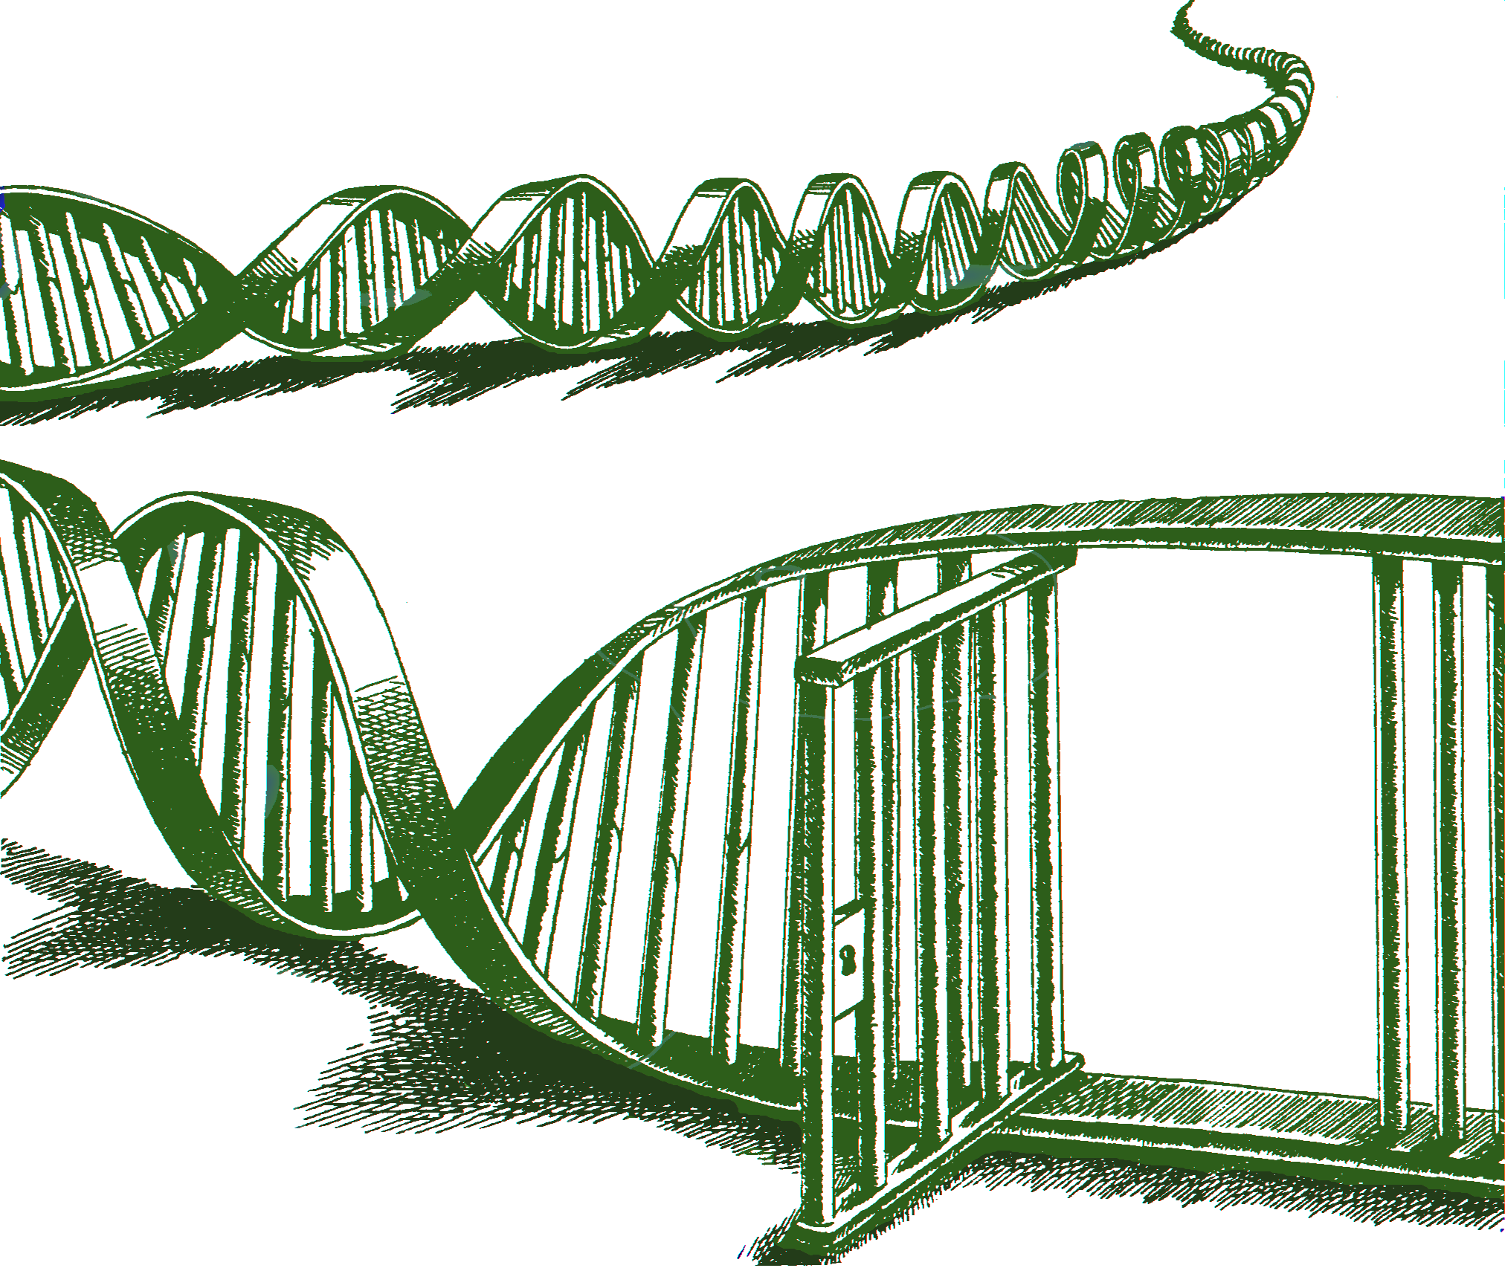
The end

